Slide 1
How to Setup Remote Pairing & Mobbing

Slide 2
Quick Demo
Let’s see it in action

Slide 3
Screen Share
Dev Environment
Switching Mechanism
So we can see the same thing
So we can code
So we can collaborate

Slide 4
Section 1: Screen Share

Slide 5
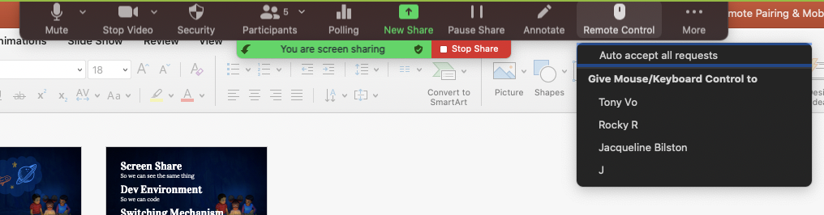
Zoom

Slide 6
Hangouts

Slide 7
Remote Desktop

Slide 8
AnyDesk

Slide 9
VS Code LiveShare

Slide 10
Section 2: Dev Environments

Slide 11
CyberDojo

Slide 12
Git-Handoff

Slide 13
Git-Handoff w/Mob

Slide 14
EC2 Machine

Slide 15
PowerShell & Chocolatey
github.com/jaybazuzi/machine-setup

Slide 16
Exercism.IO

Slide 17
Section 3: Switching Mechanism

Slide 18
For an idea to go from your head to the computer, it MUST go through the other person’s hands

Slide 19
Idea
“I have an idea,
please take the keyboard…

Slide 20
Event
Red / Green / Refactor
Task Based
Single line of code

Slide 21
Time
1-5 minutes max
Time between Keyboard
# Iteration

Slide 22
MobTime

Slide 23
mobti.me/

Slide 24
Demo: Setting up a new language
TypeScript

Slide 25
Global Day of Code Retreat
our office

Slide 26
Let’s review some concepts
Screen Share
Is the color of gold, butter and ripe lemons. In the spectrum of visible light, yellow is found between green and orange.
Dev Environments
Is the colour of the clear sky and the deep sea. It is located between violet and green on the optical spectrum.
Switching
Is the color of blood, and because of this it has historically been associated with sacrifice, danger and courage.

Slide 27
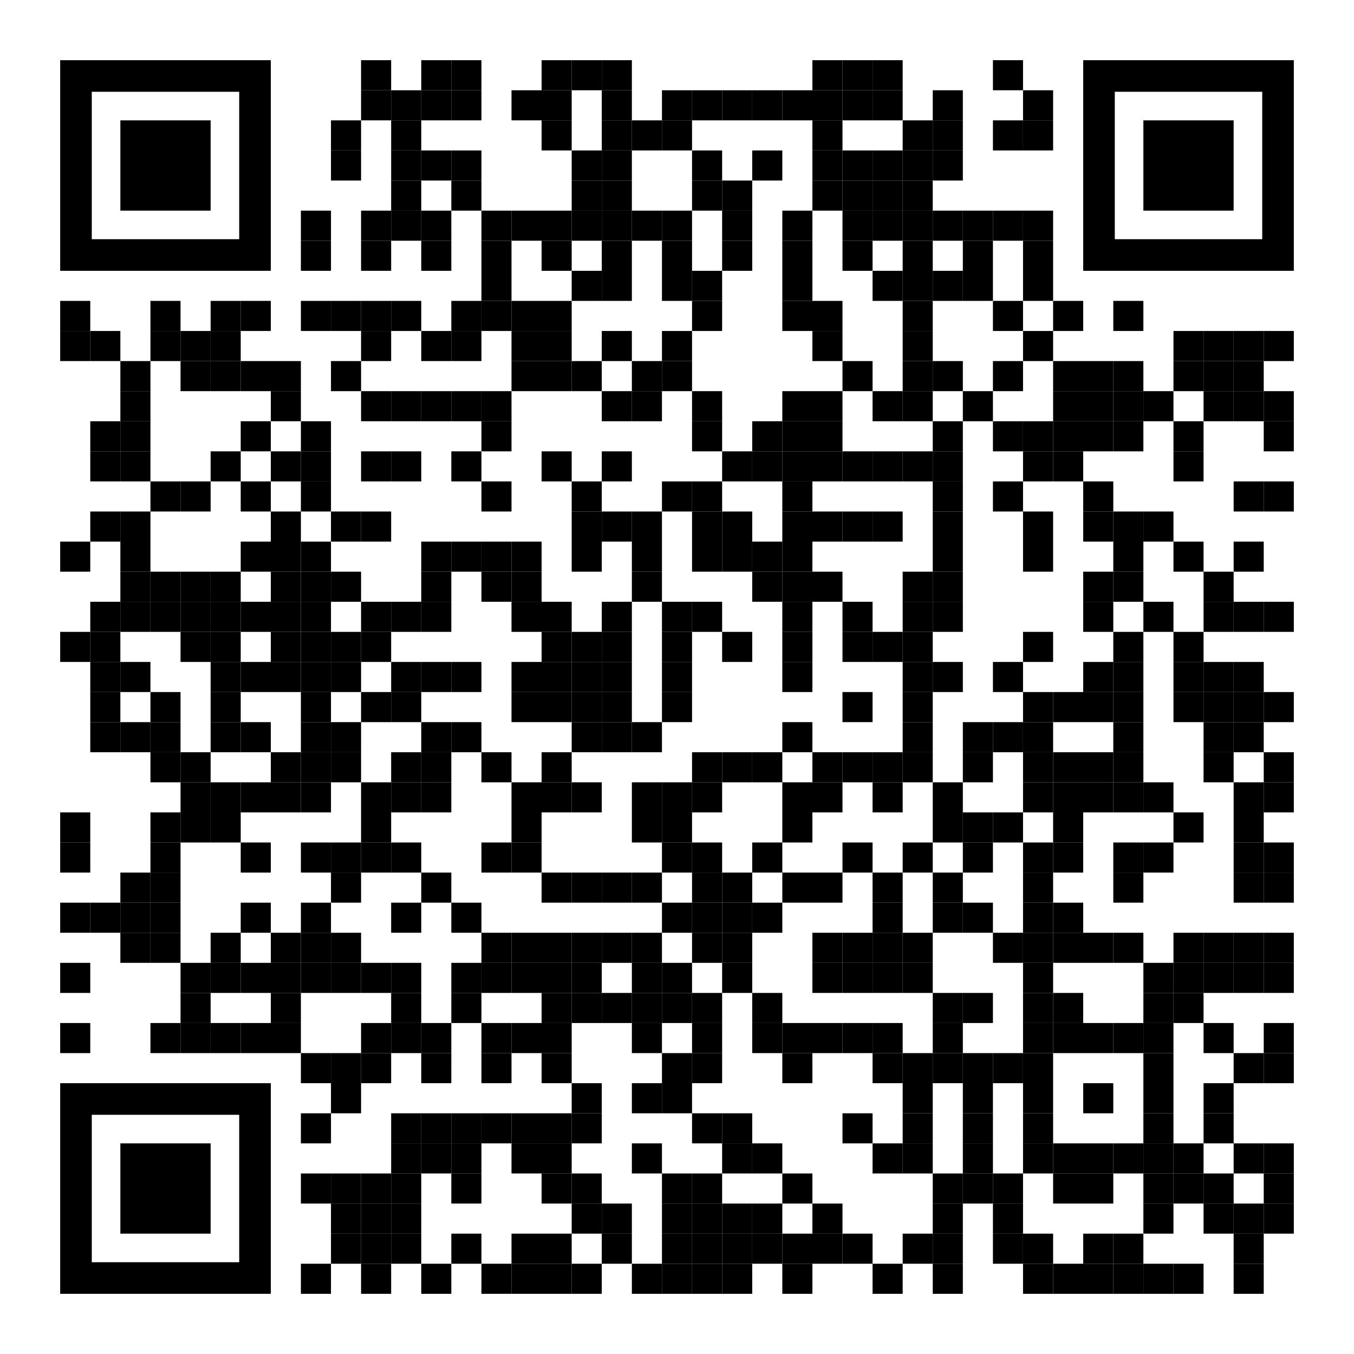
References
github.com/isidore/Talks

Slide 28
Thanks!
Any questions?
You can find me at:
@LlewellynFalco
info@spunlabs.com

